Slide 1
Jermyn Borough Council Meeting
03/21/19

Slide 2
Meeting Agenda
Call to Order
Pledge of Allegiance
Roll Call
Previous Meeting Minutes
Treasurer’s Report/Bills Payable
Correspondence
Public Comment
Reports
Reports of Committees
Rapid Cast
Police Chief Contract
Police Pension
Phone/Fax System
Rushbrook Creek Update
Executive Session
New Business
Adjournment

Slide 3
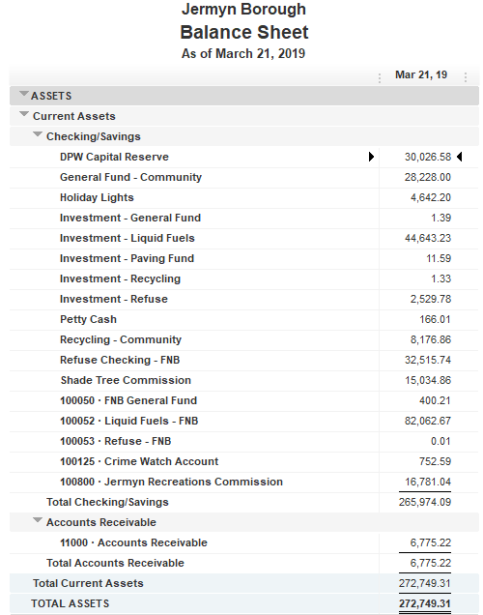
Treasurer’s Report

Slide 4
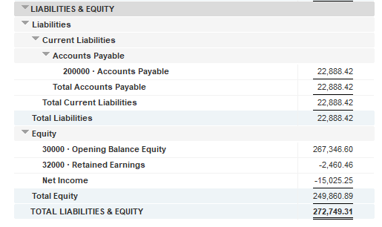

Slide 5
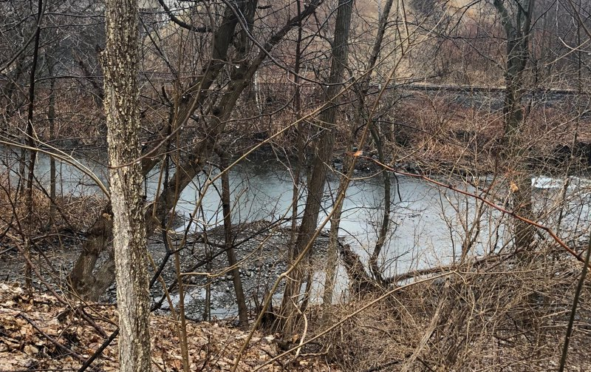

Slide 6
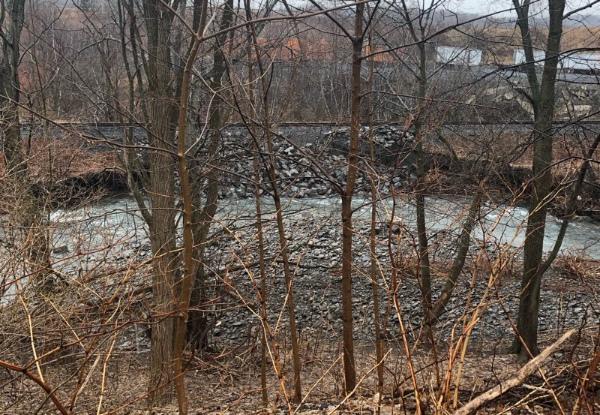

Slide 7
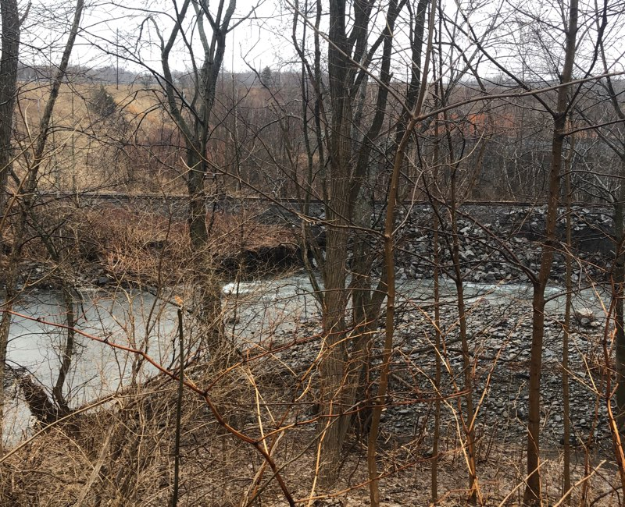

Slide 11
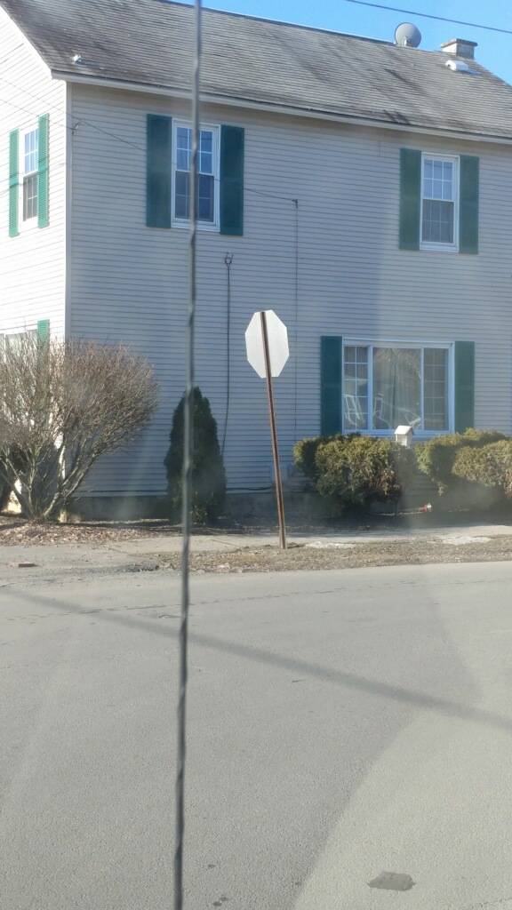

Slide 12
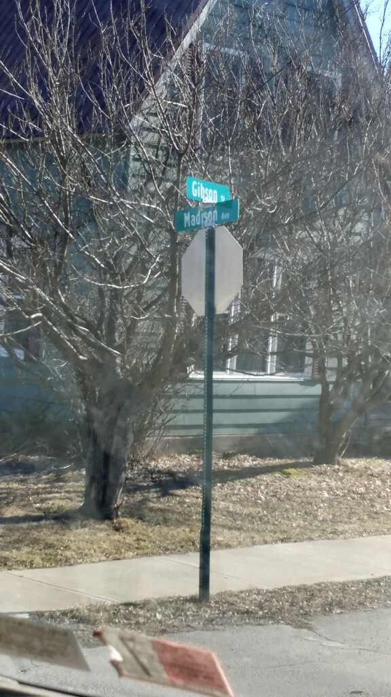

Slide 13
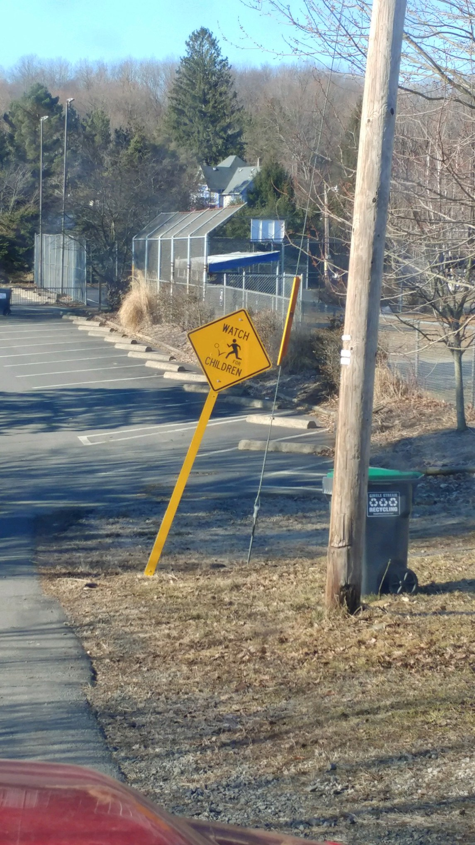

Slide 14
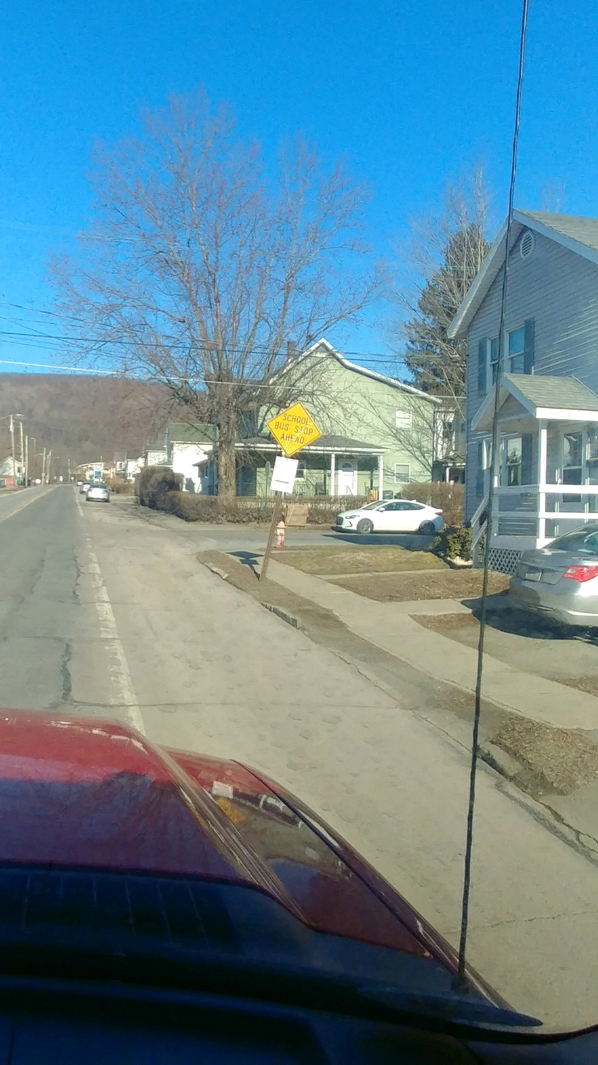

Slide 15
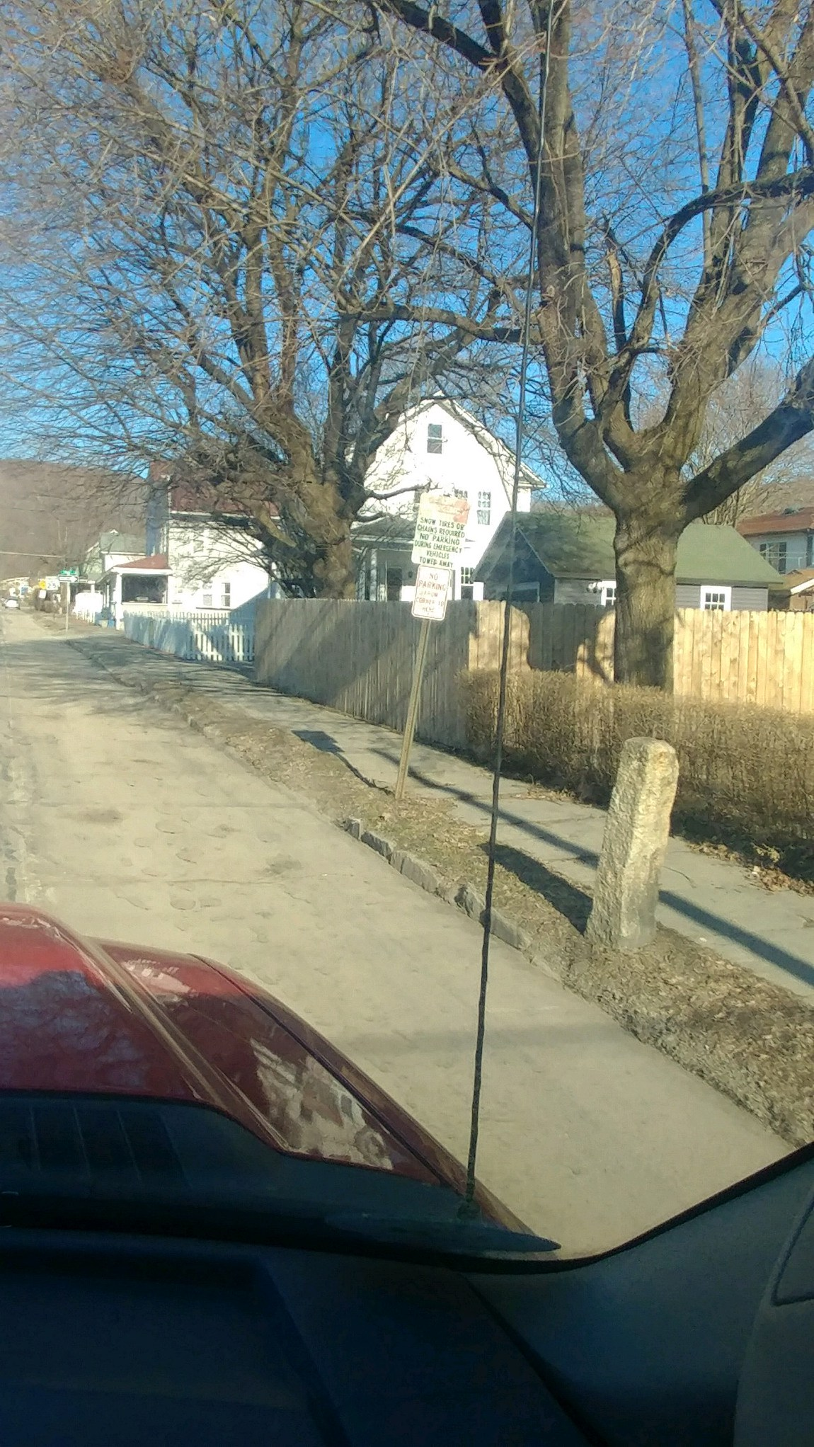

Slide 16
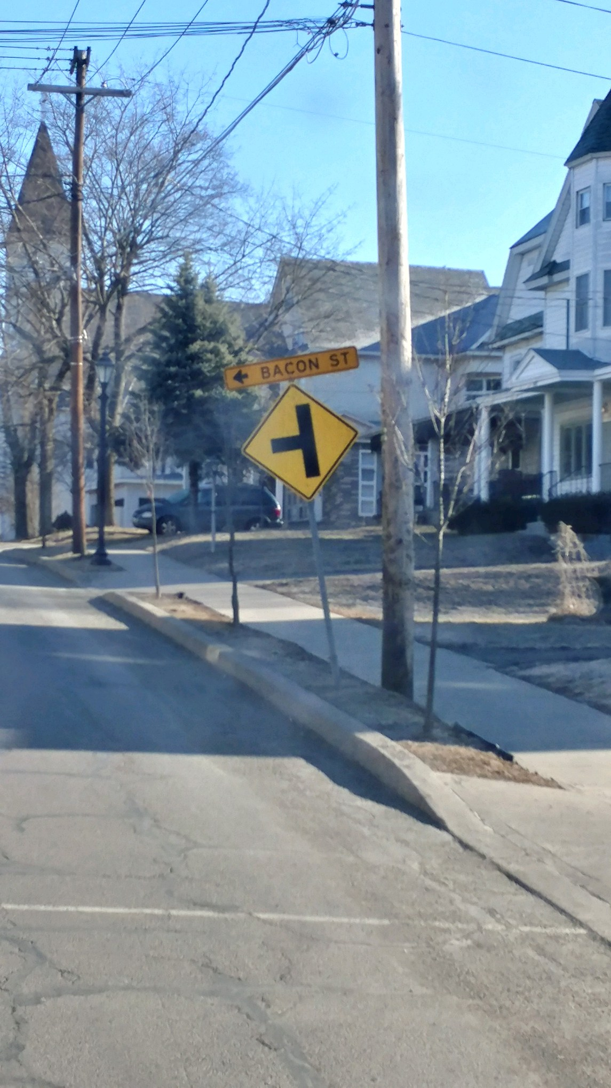

Slide 17
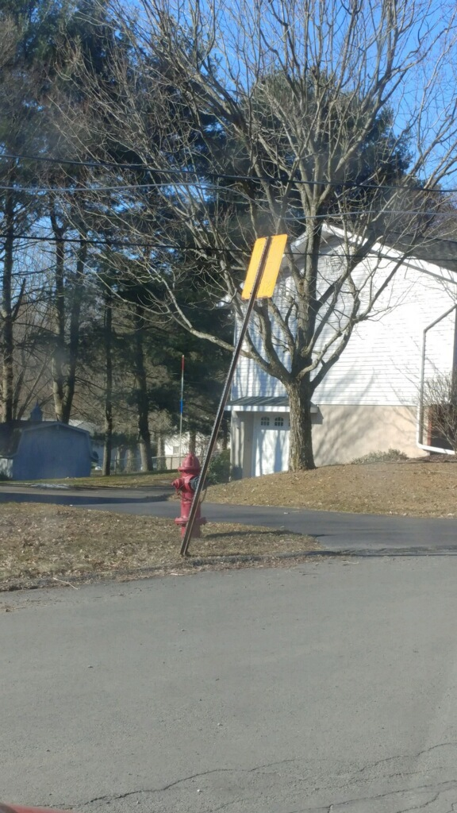

Slide 18
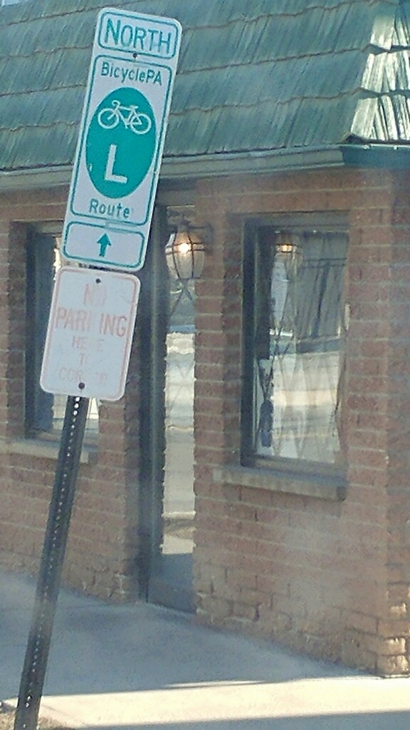

Slide 19
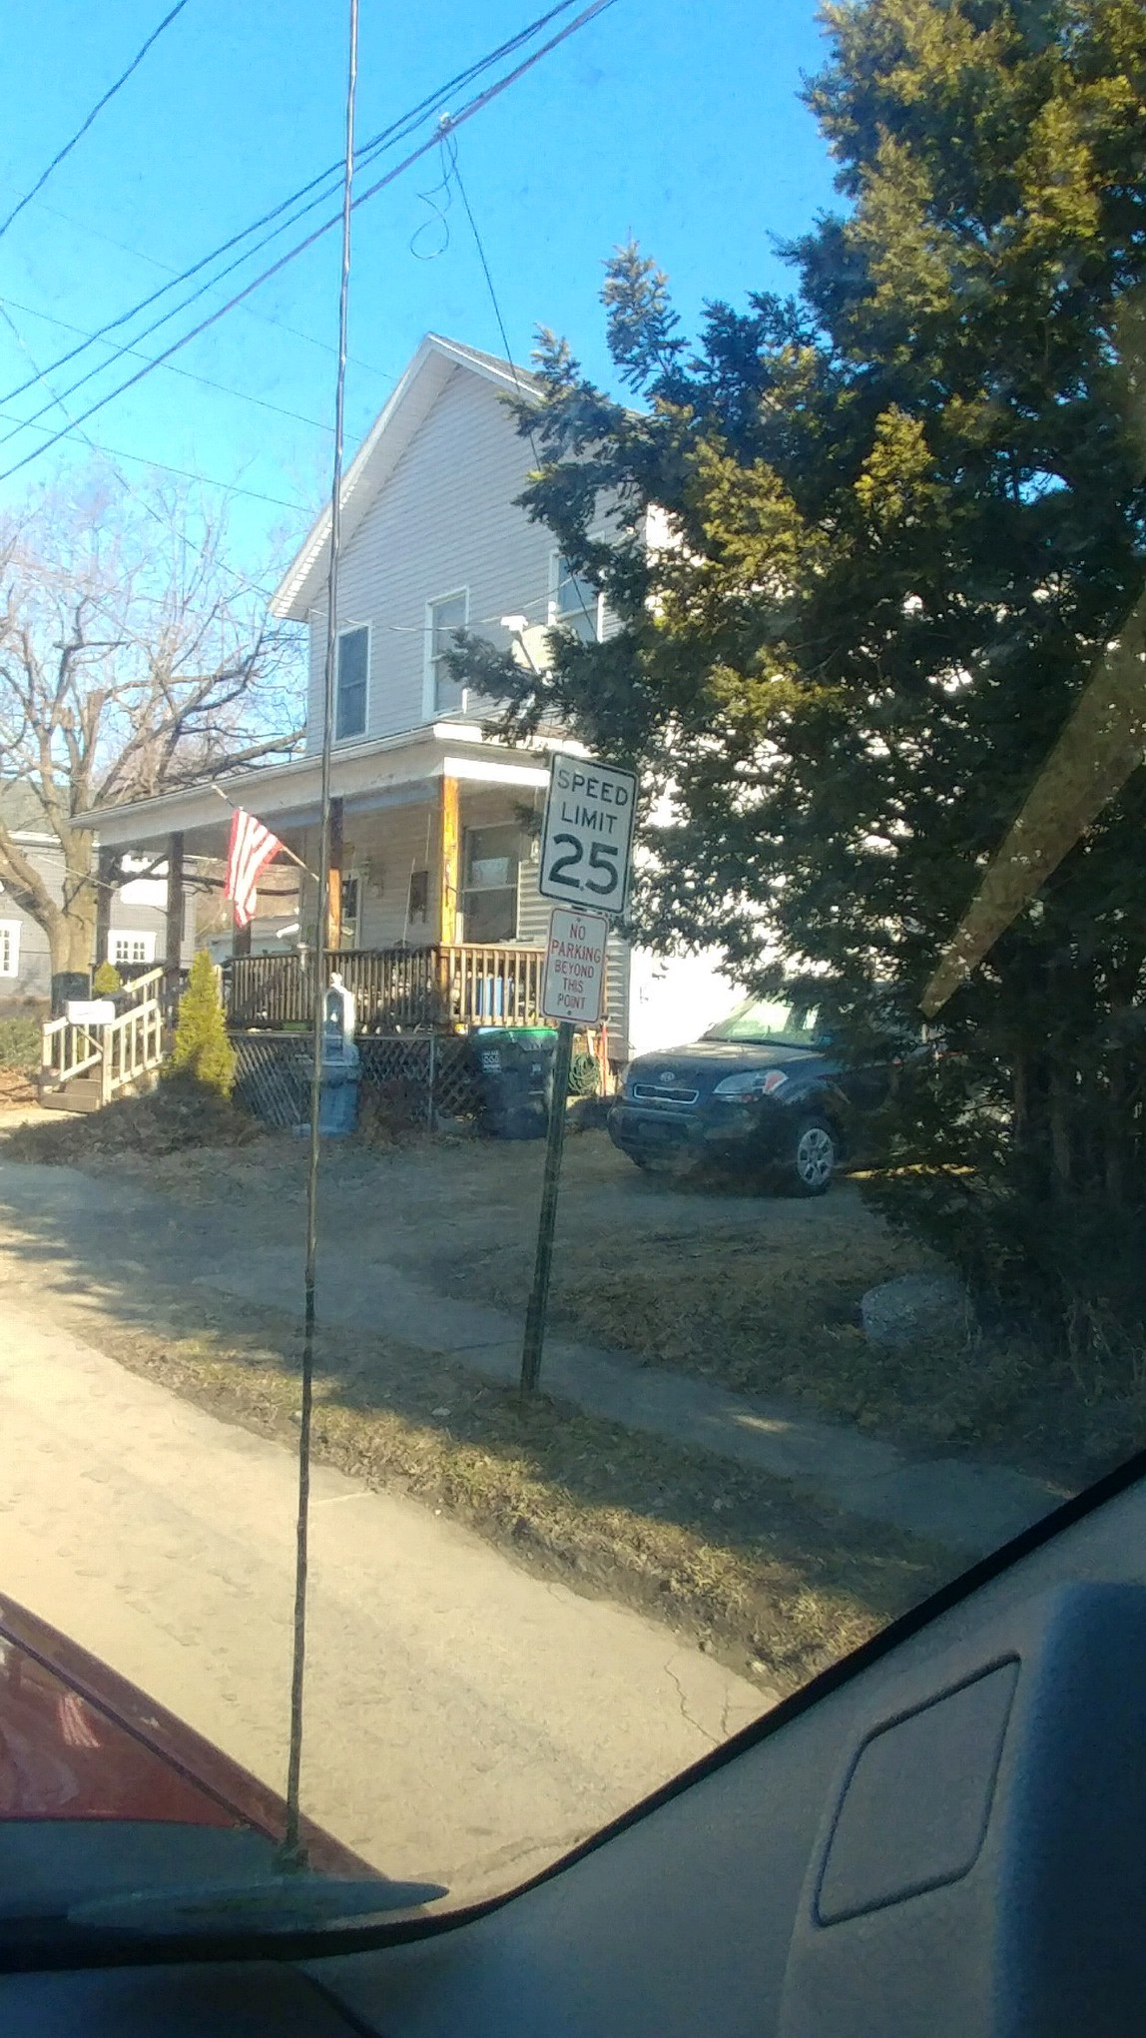

Slide 20
